Slide 1
Role of HMOs in Preterm Nutrition

Slide 2


Table of contents
1. Prematurity and related health risks
2. Role of HMOs in preterm infants
3. Clinical evidence of a HMO supplement (2’FL, LNnT) in preterm infants

Slide 3
Prematurity and Related Health Risks

Slide 4
Definition of Preterm Birth
Preterm birth: when a baby is born too early, before 37 weeks of pregnancy have been completed¹
Terminology | Gestational age
Term | 37 – 40 weeks
Preterm | < 37 weeks
Moderate / late preterm | 32 - 37 weeks
Very preterm | 28 - 32 weeks
Extremely preterm | < 28 weeks
1. WHO 2018 (fact sheet preterm birth)

Slide 5
Preterm babies face specific health risks related to their immaturity / developmental needs¹⁻²
Respiratory Distress Syndrome
Feeding difficulties / metabolic disturbances
Jaundice and higher risk for the brain
Infections
Anaemia of prematurity
Brain injury
Retinopathy of prematurity
Feeding intolerance
NEC
NEC, necrotising enterocolitis
1. WHO 2012; 2. WHO 2020 (Born too soon: the global action report on preterm birth)

Slide 6
An immature GI system leads to specific health risks in preterm infants¹⁻⁵
Gastrointestinal system
Immature gut barrier
Inefficient digestion and absorption
Immature GI motor functions
Higher vulnerability to antigens and pathogens
Immature digestion of lactose, protein and fat
Limited glucose absorption
Poor suck-swallow-coordination
Inefficient oesophageal motility
Delayed gastric emptying
Slow intestinal transit
Infection, allergy, NEC
Feeding difficulties, risk of insufficient nutrient intakes
Feeding intolerance
GI, gastrointestinal; NEC, necrotising enterocolitis.
1. Neu J, 2007; 2. Neu J, 2008; 3. Blackburn ST, 2013; 4. Omari TI and Rudolph CD, 2011; 5. Premji SS, 1998

Slide 7
A disturbed microbial colonisation of the GI tract contributes to feeding intolerance of preterm infants¹⁻⁸
Disturbed gut microbial colonisation
Internal risk factors⁷⁻¹⁰
Gestational age
Birth weight
Genetics
In utero colonisation
Delayed colonization of commensal bacteria, such as Bifidobacteria, Lactobacillus
Limited microbial diversity
Microbial disturbances persist up to 4 years of age
External risk factors⁷⁻¹¹
Antibiotics
Mode of delivery
NICU environment
Skin to skin contact
Breast milk exposure
Medical complexity, inflammation, oxidative stress
Feeding intolerance, NEC, impact on immune system development and gut barrier integrity
GI, gastrointestinal; NEC, necrotising enterocolitis; NICU, neonatal intensive care unit.
1. Di Mauro A et al., 2013; 2. Ford SL et al., 2019; 3. Fanaro S, 2013; 4. Senterre T, 2014; 5. Fouhy F et al., 2019; 6. Yuan Z et al., 2019;
7. Collado C et al., 2015; 8. Hendrickx JGE et al., 2019; 9. Lenfestey MW and Neu J, 2018; 10. Unger S et al., 2015; 11. Greenwood C et al., 2014.

Slide 8



Up to 50% of preterm babies suffer from feeding intolerance¹
Risk factors^{2,3}
Feeding Intolerance*
Consequences^{2,3}
Functional immaturity of the GI tract
Lack of coordinated GI motility
Impaired digestive function
Disturbed gut microbial colonisation
Suboptimal nutrient intake
Decreased growth rate
Delayed achievement of full enteral feeding
Prolonged dependence on intravenous nutrition
Inability to meet criteria for NICU discharge
*Feeding intolerance can be defined by the inability to digest enteral feedings (GRV > 50%), abdominal distension or emesis or both, and the disruption of the patient's feeding plan.²
GI, gastrointestinal; GRV, gastric residual volume; NICU, neonatal intensive care unit.
1. Indrio F et al., 2011; 2. Fanaro S, 2013; 3. Senterre T, 2014.

Slide 9

Achieving timely enteral feeding is critical to support and development of preterm babies
Benefits of timely enteral feeding¹⁻⁴
Promote growth
Support normal development of the GI tract
Promote nutrient intake
Support neurodevelopment and long-term health outcomes
Minimise the risk of NEC
Avoid health problems related to feeding by intravenous lines
GI, gastrointestinal; NEC, necrotising enterocolitis.
1. Fanaro S, 2013; 2. Senterre T, 2014; 3. Koletzko B, 2014; 4. Chen CM, 2012.

Slide 10
Role of HMO in Preterm Infants
HMO, Human milk oligosaccharide.

Slide 11
HMOs may play a role in mitigating the effects of NEC^{1,2*}
Pooled HMO¹
Pooled HMO, 2’FL²
*** p<0.001, **p<0.01
2’FL, 2-fucosyllactose; DF, dam fed; FF, formula fed; GOS, galacto-oligosaccharide; HMO, human milk oligosaccharide; NEC, necrotising enterocolitis; Sia, sialylated.
1. Jantscher-Krenn E et al., 2012; 2. Autran CA et al., 2016. * Animal model.

Slide 12
HMOs may play a role in mitigating the effects of NEC^{1*}
Low HMO diversity is associated with NEC in preterm infants
HMO, human milk oligosaccharide; NEC, necrotising enterocolitis; PMW, post menstrual week
1. Wejryd E et al., 2018. *Observational study.

Slide 13
HMOs may influence NEC severity by reducing TNF-𝜶 and TLR4 mediated signaling^{1*}
2’FL and 6’SL reduce NEC severity
2’FL and 6’SL reduce levels of proinflammatory TNF-𝜶 alpha
*** p<0.001
2’FL, 2-fucosyllactose; 6’SL, 6-sialyllactose; HMO, human milk oligosaccharide; Lac, lactose; NEC, necrotising enterocolitis; qRT-PCR, quantitative real-time polymerase chain reaction; TLR4, toll-like receptor 4; TNF-𝜶, tumor necrosis factor alpha.
1. Sodhi CP et al., 2020. *Animal studies in combination with experimental studies

Slide 14
Fucosylated HMOs may reduce gut microbiota dysbiosis in premature infants^{1*}
Fucosylated HMOs
Non-Fucosylated/ non-sialylated HMOs
R²=0.63, p=0.002
R²=0.48, p=0.01
R²=0.36, p=0.04
R²=0.42, p=0.02
Higher levels of fucosylated HMOs are associated with:
Higher levels of commensal Firmicutes
Lower levels of primarily harmful Proteobacteria
Higher levels of non-fucosylated or non-sialylated HMOs are associated with:
Lower levels of commensal Firmicutes
Lower levels of primarily harmful Proteobacteria
HMO, human milk oligosaccharide.
1. Underwood MA et al., 2013. *Observational study, n=12.

Slide 15
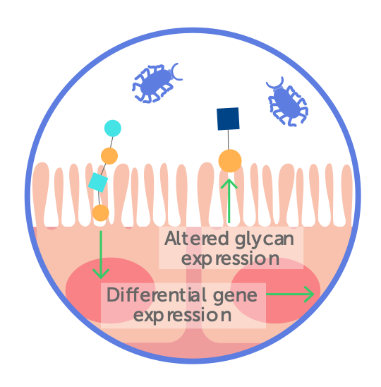
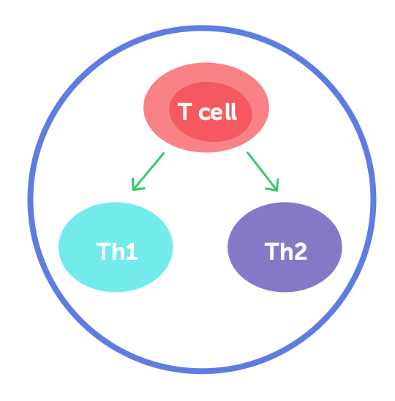
HMOs help the immune defences in 4 main ways¹⁻⁵
Promote the growth of beneficial bacteria
Prevent pathogen adhesion in the gut
Strengthen gut barrier function
Educate the developing
immune system
+HMOs
+HMOs
+HMOs
+HMOs
HMO, human milk oligosaccharide.
1. Underwood MA et al., 2013; 2. Zivkovic AM et al., 2011; 3. Zivkokiv AM et al., 2013; 4. Bode L, 2015; 5. Donovan SM et al., 2016.

Slide 16
Most levels of HMOs are lower in preterm milk compared to term milk, at equivalent developmental status¹*
The largest differences are seen around 40 postmenstrual weeks
2’FL
LNnT
c
c
a
a
c
c
Term milk
Preterm milk
a, p<0.05
c, p<0.0005
2’FL, 2-fucosyllactose; HMO, human milk oligosaccharide; LNnT, Lacto-N-neotetraose.
1. Austin S et al., 2019. *Observational study

Slide 17


Preterm infants may have insufficient HMO intake
Mother’s own milk
Donor milk
Alternative feeds
Levels of HMOs may be reduced¹
Pasteurisation and sterilisation reduce levels of HMOs in donor milk^{2,3}
Do not currently contain HMOs
HMO, human milk oligosaccharide.
1. Austin S et al., 2019; 2. Marx C et al., 2014; 3. Meredith-Dennis L et al., 2018.

Slide 18
HMOs are the 3rd largest solid component in human milk
> 200 HMOs identified
20-30 HMOs quantified⁴⁻¹¹
Three main HMO categories based on their building blocks⁴⁻¹¹
Solid components¹⁻³
Proteins (8 g/L)
Non-fucosylated neutral (core) HMOs e.g., LNnT, LNT
HMOs (5-15 g/L)
Lipids (40 g/L)
Fucosylated neutral HMOs e.g., 2’FL, DFL
Lactose (70 g/L)
Sialylated acidic HMOs e.g., 6’SL, 3’SL
DFL, difucosyllactose (also named as LDFT, lactodifucotetraose); DFLNHa, difucosyllacto-N-hexaose a; DSNLT, disialyllacto-N-tetraose; FL, fucosyllactose; HMO, human milk oligosaccharide; LNDFH, lacto-N-difucohexaose; LNFP, lacto-N-fucopentaose; LNT, lacto-N-tetraose; LNnT, Lacto-N-neotetraose; LST, sialyl-lacto-N-tetraose; MFLNH, monofucosyllacto-N-hexaose; SL, sialyllactose.
1. Zivkovic AM et al., 2011; 2. Zivkokiv AM et al., 2013; 3. Bode L, 2012; 4. Hennet T et al., 2014; 5. Bode L, 2015; 6. Thurl S et al., 2017; 7. Austin S et al., 2016; 8. Sprenger N et al., 2017; 9. Samuel TM et al.,2019; 10. Austin S et al., 2019; 11. Lefebvre G et al., 2020.

Slide 19
Clinical Evidence of a HMO Supplement (2’FL, LNnT) in Preterm Infants
HMO, Human milk oligosaccharide.

Slide 20
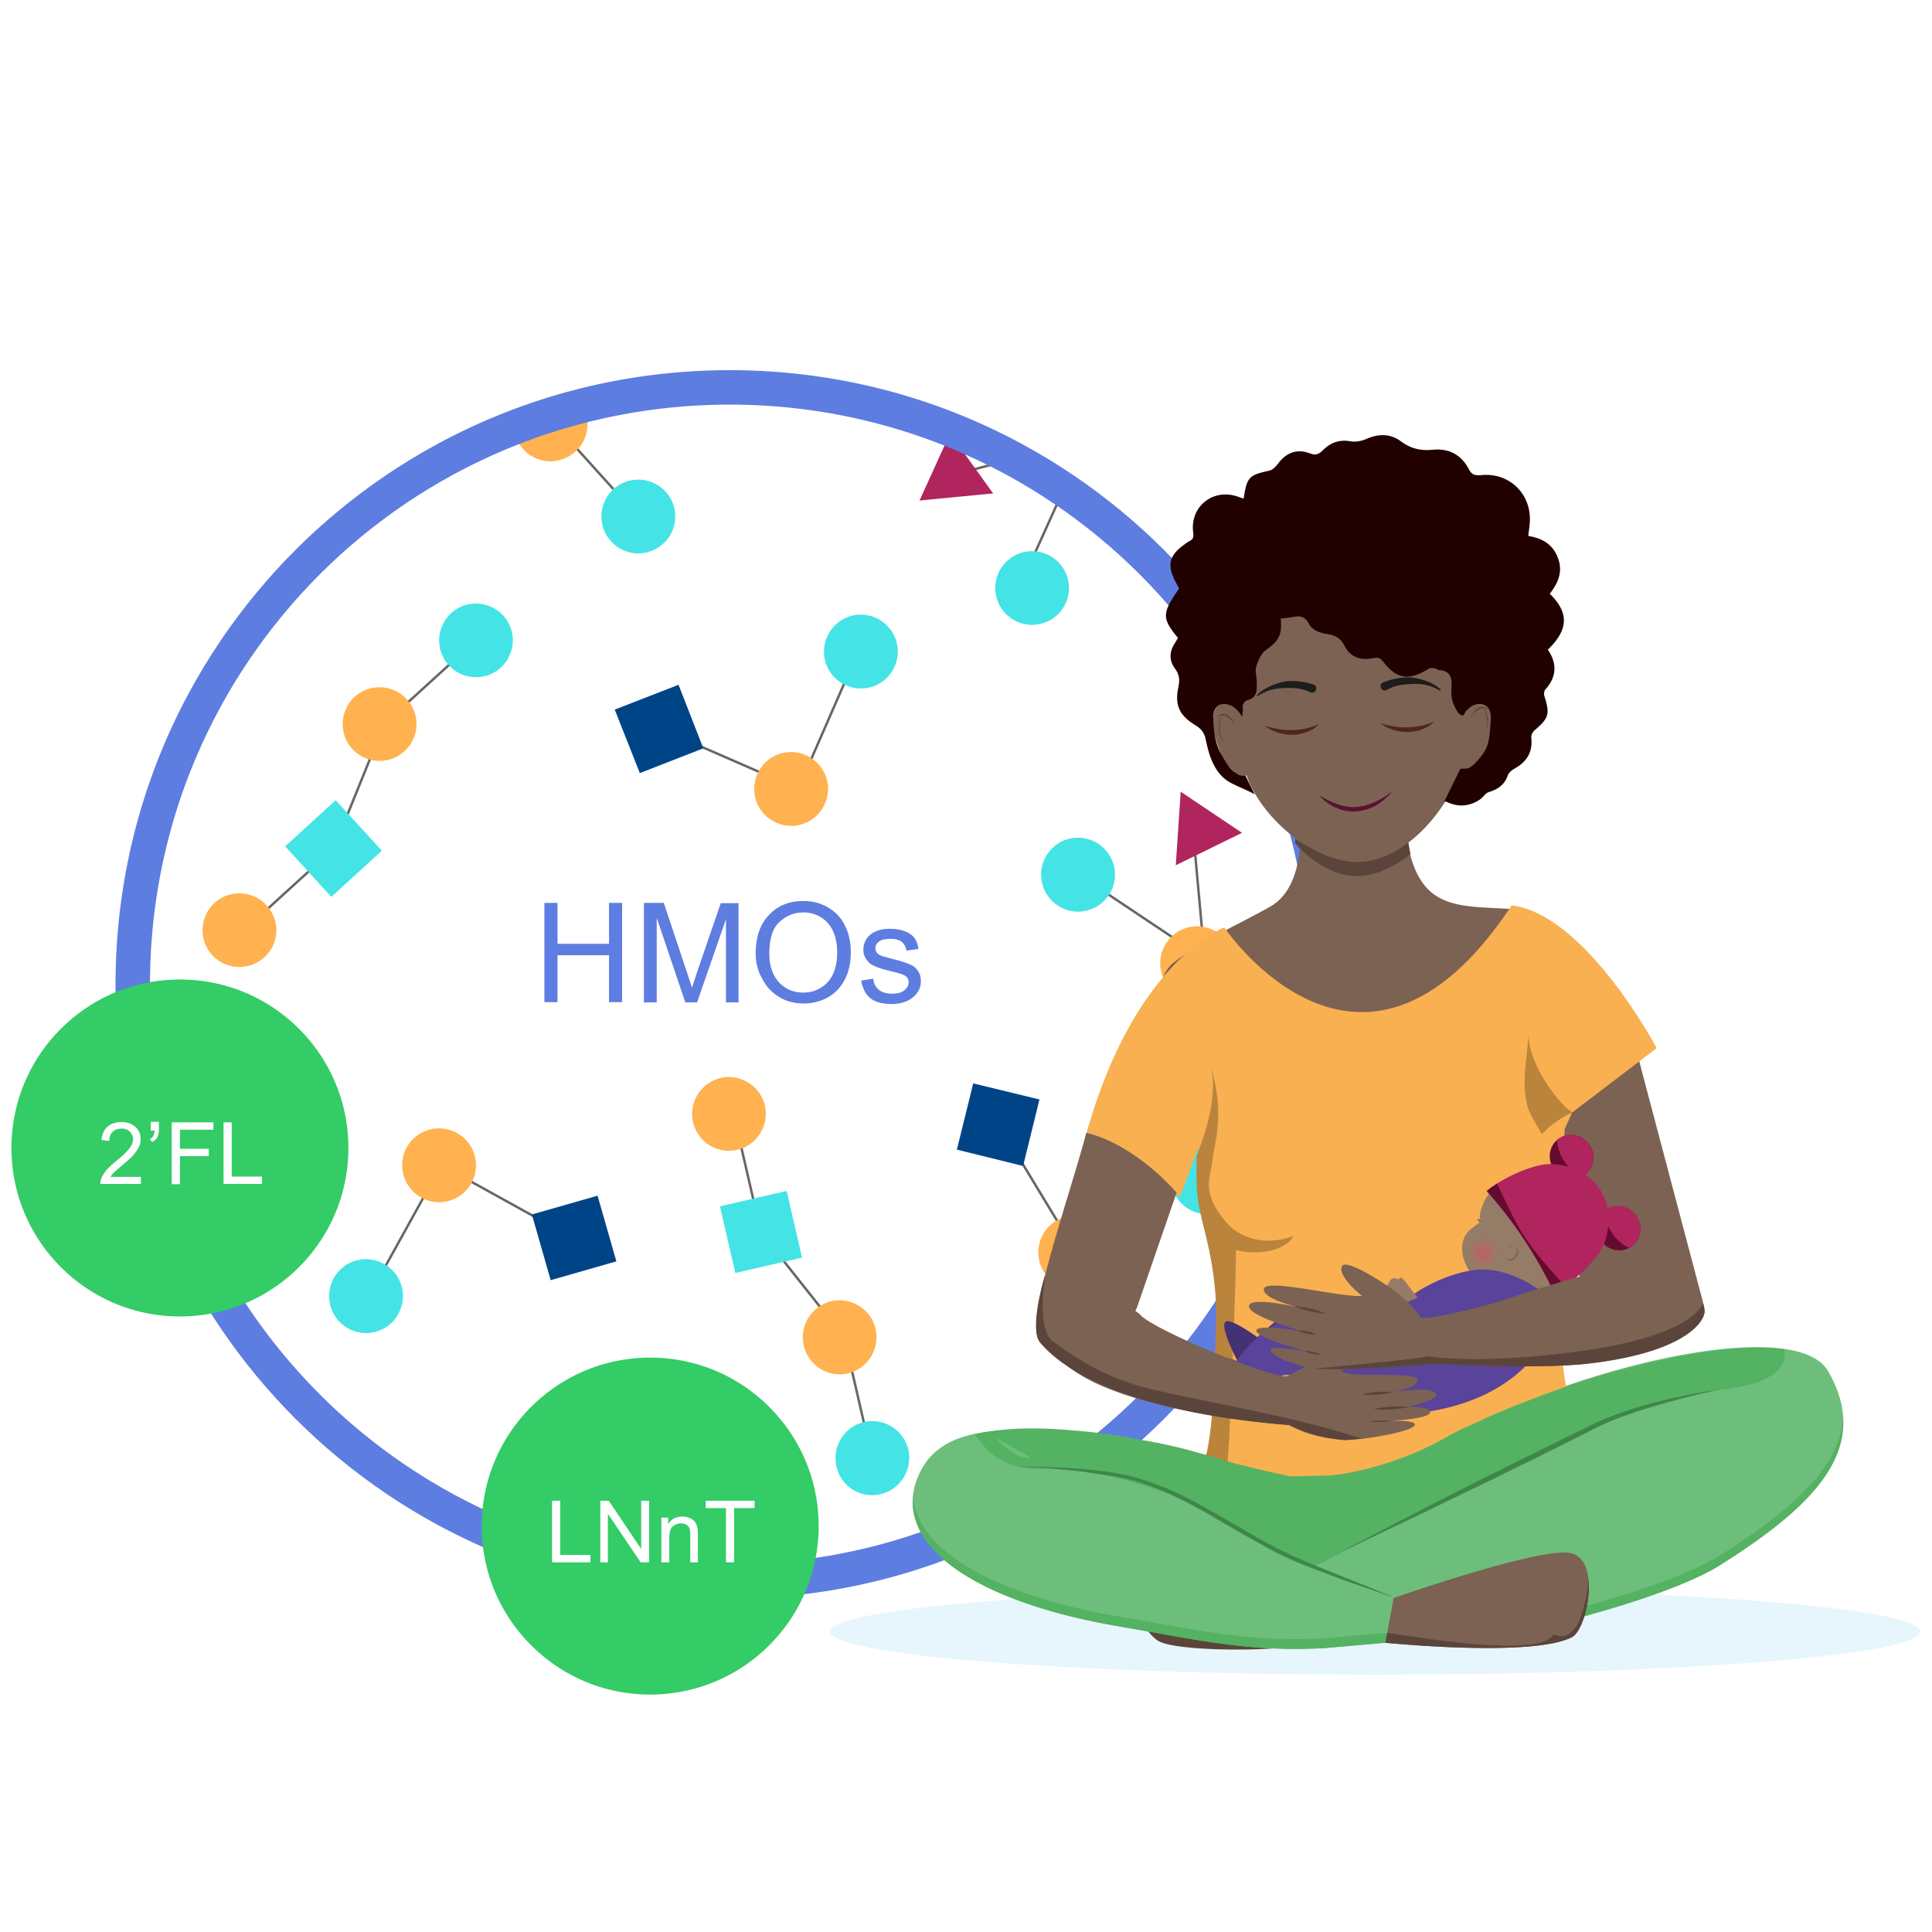
With HMO supplement (2’FL and LNnT), the mean time to reach full enteral feeding was 2 days shorter^{1*}
Full enteral feeding^
Placebo
(n=43)
14,3
HMO (2’FL, LNnT) supplement
(n=43)
12,2
2 days shorter
0
5
10
15
Faster progression to FEF may help reduce the risk of growth restriction and exacerbated gut immaturity¹
^Time to reach full enteral feeding is a reliable indicator of feeding tolerance
2’FL, 2-fucosyllactose; HMO, human milk oligosaccharide; LNnT, Lacto-N-neotetraose.
1. Hascoët JM et al., Abstract at WCPGHAN 2021. * Randomised, clinical trial

Slide 21
HMO supplement (2’FL and LNnT) supports adequate growth, in line with preterm growth standards^
HMO supplement supports early postnatal growth, which may have a positive impact on long-term growth and developmental outcomes^{1*}
Weight-for-age Z-scores
Length-for-age Z-scores
^Fenton growth standards for preterm infants
2’FL, 2-fucosyllactose; FEF, full enteral feeding; HMO, human milk oligosaccharide; LNnT, Lacto-N-neotetraose
1. Hascoët JM et al., Abstract at WCPGHAN 2021. * Randomised, clinical trial

Slide 22

HMO supplement (2’FL and LNnT) supports adequate growth, in line with preterm growth standards^
Head circumference-for-age Z-scores
HMO supplement supports early postnatal growth, which may have a positive impact on long-term growth and developmental outcomes^{1*}
^Fenton growth standards for preterm infants
2’FL, 2-fucosyllactose; FEF, full enteral feeding; HMO, human milk oligosaccharide; LNnT, Lacto-N-neotetraose
1. Hascoët JM et al., Abstract at WCPGHAN 2021. * Randomised, clinical trial

Slide 23
HMO supplement (2’FL and LNnT) supports adequate gastrointestinal tolerance
 | HMO Range of means | Placebo Range of means
Daily gastric residual volume (in mL/kg/day) | 0.05 - 3.06 | 0.07 - 3.29
Daily stool frequency | 3.09 - 4.17 | 3.11 - 4.20
Stool consistency (1=watery, 2=runny, 3=mushy soft, 4=formed, 5=hard) | 2.97 - 3.11 | 2.91 - 3.19
Difference from stool consistency of 3 (mushy soft) | 0.13 - 0.33 | 0.16 - 0.50
Gastrointestinal tolerance¹*
2’FL, 2-fucosyllactose; FEF, full enteral feeding; HMO, human milk oligosaccharide; LNnT, Lacto-N-neotetraose
1. Hascoët JM et al., Abstract at WCPGHAN 2021. * Randomised, clinical trial

Slide 24
Takeaway message
Preterm infants are a vulnerable group of neonates which may have insufficient HMO intake.
Supplementing the HMO 2’FL and LNnT promotes early full enteral feeding versus placebo.
Faster progression to full enteral feeding may help reduce the risk of growth restriction and exacerbated gut immunity.
HMO supplement (2’FL and LNnT) supports early postnatal growth, which may have a positive impact on long-term growth and developmental outcomes.
2’FL, 2-fucosyllactose; FEF, full enteral feeding; HMO, human milk oligosaccharide; LNnT, Lacto-N-neotetraose.

